Slide 1

Obstetric sonography overview
By
Faculty of MIATA

Slide 2


Slide 3
UNDERSTANDING THE TRIMESTERS
A normal pregnancy lasts for 9 months, 40 weeks, or 280 days.
However, it may last up to 42 weeks.
As a result, typically the first trimester is defined as weeks 1 through 12, the second trimester is defined as weeks 13 through 26, and the third trimester is defined as weeks 27 through 42.
Fetal age is determined by the last menstrual period, which may be referred to as menstrual age or gestational age

Slide 4
CLINICAL INDICATIONS FOR AN OBSTETRIC SONOGRAM
An obstetric sonogram may be requested for various reasons.
The American Institute of Ultrasound in Medicine (AIUM) publishes the practice guidelines for an obstetric sonogram on their website at www.aium.org (Tables 22-1 and 22-2).

Slide 7
PATIENT PREPARATION FOR AN OBSTETRIC SONOGRAM AND PATIENT CARE
Both transvaginal (TV) and transabdominal (TA) imaging may be utilized to evaluate the gravid uterus.
Although both techniques have their limitations, they often work well in conjunction with each other.
In the early first trimester, if TA imaging is used, the patient should have a distended urinary bladder to better visualize not only the uterus, but also the adnexa.
TV imaging is most often the technique used to imagine the early pregnancy, as it offers superior resolution.
An empty maternal bladder is needed for this exam.
Second and third trimester sonographic examinations also require an empty maternal bladder.

Slide 8
First trimester sonograms may require the use of a 5- to 10-MHz or higher TV transducer to better visualize intrauterine structures and the adnexa.
Typically, a 3- to 5-MHz TA transducer will allow sufficient penetration in most pregnant patients, while providing sufficient resolution.
These frequency ranges will vary among ultrasound equipment.
Obese patients may require the use of lower frequency transducers for additional penetration.

Slide 9
All transducers and transducer cords should be cleaned after performing an obstetric sonogram to prevent the spread of disease.
TV transducers should be soaked in a disinfecting solution and the manufacturer’s specified instructions should be followed.
Since TV imaging requires that the transducer be placed into the vagina, a probe cover should be placed on the transducer and it should be inserted into the vagina using sterile jelly as a lubricant.

Slide 10
While evaluating the gravid patient, the sonographer should be aware of a unique situation that may arise during the examination.
Patients in their late second or third trimester may suffer from supine hypotensive syndrome, which is a reduction in blood return to the maternal heart caused by the gravid uterus compressing the maternal inferior vena cava.
Patients can complain of tachycardia, sweating, nausea, and pallor.
The sonographer can assist the patient into a right lateral or left lateral position to alleviate symptoms.

Slide 11
GATHERING A CLINICAL HISTORY
A review of prior examinations should be performed by the sonographer before any interaction with the patient.
This review includes previous sonograms and other imaging studies when applicable.
Moreover, sonographers must be capable of analyzing the clinical history and complaints of their patients.
This practice will not only aid in clinical practice, but will also assist in answering complex certification examination questions

Slide 12
By correlating clinical findings with sonographic findings, the sonographer can directly impact patient care by providing the most targeted exam possible.
Furthermore, when faced with a complicated, in-depth registry question, the registrant will be able to eliminate information that is not relevant in order to answer the question appropriately.
Although questions in the obstetric portion of these registries may have some clinical history, like laboratory findings, many are image-based questions that examine the reviewer’s ability to discern sonographic anatomy and pathology.
For this reason, crucial sonographic images and diagrams are provided throughout this section

Slide 13
Determining the cause of vaginal bleeding is a common obstetrical dilemma.
Although vaginal bleeding can be idiopathic, in the first trimester the sonographer should be aware that there can be multiple reasons why a patient could present with vaginal bleeding, including ectopic pregnancy, gestational trophoblastic disease, miscarriage, blighted ovum, embryonic demise, and subchorionic hemorrhage.
In the second trimester, painless vaginal bleeding is most often associated with placenta previa, while painful vaginal bleeding may occur as a result of placental abruption.

Slide 14
LABORATORY FINDINGS RELEVANT TO OBSTETRIC SONOGRAPHY

Slide 15
The Triple and Quadruple Screen
The triple screen is a maternal blood test performed between 15 and 20 gestational weeks. It includes human chorionic gonadotropin (hCG), maternal serum alphafetoprotein (MSAFP), and estriol.
The quadruple screen adds an additional analysis of inhibin A.
Atypical laboratory findings can be associated with abnormal pregnancies (Table 22-3).

Slide 17
Early First Trimester Screening
Some medical institutions provide an earlier test than the customary triple screen offered during the second trimester.
This test can be performed between 11 and 14 gestational weeks.
It is an analysis of maternal blood levels of hCG and pregnancy-associated plasma protein A (PAPP-A), combined with fetal nuchal translucency (NT) measurements obtained with sonography.

Slide 18
FETAL BIOMETRY
Measurements obtained in the first trimester include yolk sac, gestational sac, crown rump length, and NT.
These are discussed in the following chapters.
Although standard fetal biometry of the second and third trimester is also discussed in the following chapters of this book,

Slide 19
ARTIFACTS IN OB IMAGING
Obstetric sonography involves careful analysis of vital fetal and maternal structures.
Often, artifacts will be observed during an obstetric sonogram.
It is important to know that artifacts exist and why they occur (Table 22-5).

Slide 21
BIOPHYSICAL PROFILE SCORING
The purpose of biophysical profile scoring is to investigat for signs of fetal hypoxia.
Each examination of the fetus lasts 30 minutes.
The sonographic examination is scored according to specific fetal movements (Table 22-6).
The highest possible sonographic score is 8 points, or 2 points for each criterion accomplished.
The nonstress test, also referred to as fetal cardiotocography, is worth 2 additional points.
Therefore, if combined with a nonstress test, the highest possible score is 10 for a biophysical profile.

Slide 23
FETAL PRESENTATION
Determining fetal lie and presentation is a significant element of an obstetric sonogram.
Fetal lie can be described as longitudinal or transverse.
A longitudinal lie is present when the fetus lies along the longitudinal axis of the uterus, whereas transverse is when the fetus lies transversely within the uterus.

Slide 24
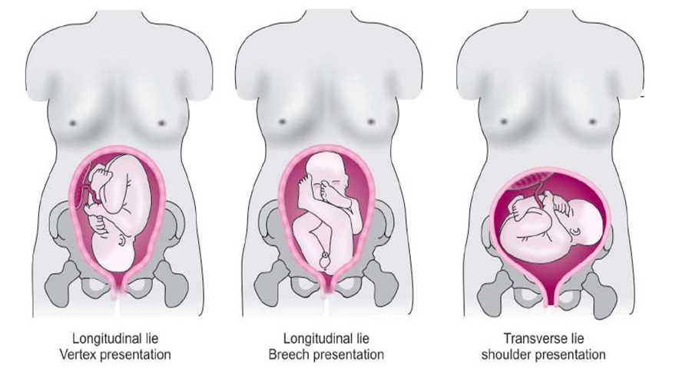
Cephalic

Slide 25


Slide 26
Presentation of the fetus is determined by identifying the fetal anatomy that is closest to the internal os of the cervix.
Cephalic presentation, or head first, is the most common presentation.
A breech presentation can be further described as complete, incomplete (footling), or frank.
A complete breech is when the fetal legs are flexed at the hips, and there is flexion of the knees also.
Frank breech presentation is when the fetal buttocks are closest to the cervix, whereas footling breech is when there is extension of at least one of the legs toward the cervix (Fig. 22-1).

Slide 27
EXTRAUTERINE ABNORMALITIES ASSOCIATED WITH OBSTETRIC SONOGRAPHY
During a sonographic examination of the gravid patient, the sonographer must not only be aware of the fetal findings, but also cognizant of the surrounding maternal pelvic anatomy, including the ovaries and adnexa.
The most common pelvic mass associated with pregnancy is the corpus luteum cyst of the ovary.
These cysts can have a complex appearance, or a thick wall, and may therefore mimic an ectopic pregnancy. Large ovarian cysts or masses can lead to ovarian torsion.
If a patient presents with a large ovarian abnormality, further sonographic signs of ovarian torsion must be investigated..

Slide 29
Pregnant patients who complain of right lower quadrant pain could be suffering from co-existing acute appendicitis.
The appendix may be visualized with endovaginal imaging as well.
Pregnant patients complaining of right upper quadrant pain could have gallstones.

Slide 30
Hydronephrosis is common during late pregnancy.
Dilation of the renal collecting system is most often secondary to the large size of the uterus with subsequent transient asymptomatic obstruction of the ureters.
However, some patients will often suffer from back pain.
A thorough analysis for urinary calculi must be performed in these situations.

Slide 31
ANALYZING AN OBSTETRIC REGISTRY QUESTION
Registry examinations can be intimidating.
Unfortunately, clinical history during late pregnancy may not be helpful.
For obstetric questions, laboratory findings, and an accurate recognition of sonographic anatomy
are vital to answering the question correctly.
Here are a couple of steps that you can use to give you a better chance at answering these complex questions.
Read the question below and look at the image (Fig. 22-2).

Slide 33
The above image is of the gravid uterus of a 39-yearold patient who presented to the ultrasound department with a history of elevated MSAFP.
She states that the fetus appears to have been moving regularly, and she has had no pain or vaginal bleeding.
What is the most likely diagnosis?
A. Spina bifida
B. Trisomy 18
C. Endometriosis
D. Anencephaly

Slide 34
Step 1: Look at the image and try to answer the question without looking at the answers provided.
As you study, you need to look at as many sonographic images as you can.
There are images provided for quick reference.
The more sonographic images you look at, the better prepared you will be to answer image based questions.
Try to determine what part of the fetus is being shown in the image.
This step may eliminate some of the incorrect answers immediately.

Slide 35
Step 2: If you don’t know the answer right away from the image, then look at the question, and begin to break it down.
Let us assume that you have no idea what the answer is from looking at the image.
Then you move on to step 2, which is breaking the question down.
This step is complicated, but it will help.
The first part of the question provides the age of the patient, which is 39 years.

Slide 36
By simply knowing what advance maternal age is (35), we know that she is at increased risk for having a complicated pregnancy, and that she is more likely to have a fetus with an abnormality.
Look at the answers provided. Is there one that you can eliminate solely on the patient’s age or irrelevance?

Slide 37
There is one, endometriosis doesn’t make sense.
Mark it off the list! You now have a 33% chance of answering the question correctly.
We now move on to the next part of the patient’s history, which is the elevated MSAFP.
Look at the answers and see if there are any that you can eliminate that are not linked with elevated MSAFP.
There is one choice that can be eliminated. Trisomy 18 is typically not linked with an elevated MSAFP.

Slide 38
Now, you have a 50% chance at getting the question correct.
This is where the following chapters will help. You must know your sonographic findings to correctly answer these questions.
This is an image of the fetal head.
The correct answer is anencephaly.
The cranium is absent above the orbits with anencephaly, as seen in this image.

